Slide 1
Software Design -
Software Architecture
Phil Pfeiffer
February 2013
Key Source: Barrett course notes, CSCI 5300, spring 2010

Slide 2

The First Word
Have an architecture that makes sense before you write 3.5 million lines of code.
Patrick Naughton
one of original creators of Java
creator of xlock
author: The Java Handbook,
Java: the Complete Reference
CTO, Disney Internet Group
cited at http://www.martinsweb.com/whitepapers/jbc_04_01.pdf

Slide 3
Definition
High-level characterization of major concerns:
▪ Elements
▪ Interactions
▪ Patterns of composition
▪ Constraints
Software Architecture, Shaw and Garlan

Slide 4
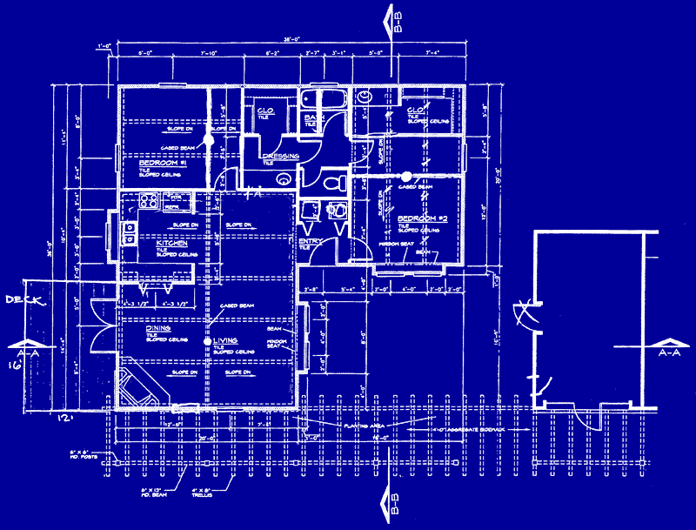
Software Architecture vs.
Building Architecture
Elements
  infrastructure
  wiring
  plumbing
  usage plan …
Interactions
  conduits
  room usage …
Patterns of composition
  wiring closets
  firewalls…
Constraints
  building codes
  operating budget
  aesthetics …

Slide 5
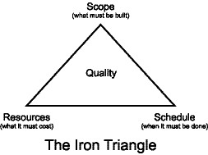
Software Architecture: Uses
Characterizing a system and its evolution
Supporting communication
among stakeholders
▪ Stakeholder concerns: i.e.,
requirements, objectives,
intentions, aspirations
▪ Developer concerns
▪ Stakeholder-developer negotiations
Evaluating and comparing architectures
Planning, managing, executing
development
Expressing persistent characteristics
and principles, as guide to change
Verifying compliance
Recording contributions of
architects
source: Wikipedia, IEEE 1471-2000

Slide 6
ANSI/IEEE 1471-2000
Standard characterizing architectures and their elements
Key points
▪ Architectures address stakeholder concerns
▪ Architectures do so using viewpoints
▪ Viewpoint: set of related concerns
▪ Functional/logical
▪ Code/module
▪ Development/structural
▪ Concurrency/process/runtime/thread
▪ User action/feedback
▪ Physical/deployment
▪ Data view/data model
▪ View: application of viewpoint to a system

Slide 7
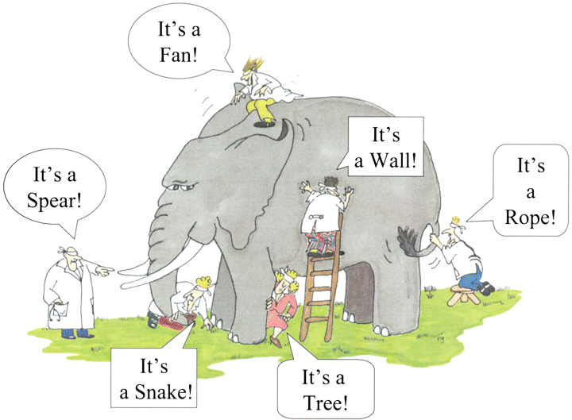
ANSI/IEEE 1471-2000
Introduction: project id, version, overview
Identification of stakeholders and their relevant concerns
Specification of each viewpoint, rationale for its selection
One or more architectural views
Record of all known
inconsistencies
amongst
an architecture's
constituencies
Rationale for
architecture selection

Slide 8
Architecture Format: Diagrams + Text
▪ Diagrams for element relationships (static, dynamic)
▪ UML - well-known, but has its limitations
▪ Box-and-arrow diagrams
▪ Formal architecture languages
▪ Textual explanations of factors governing design

Slide 9
Architecture: System Characterization
▪ Described using limited num. key viewpoints
▪ Think: Miller limit (7 +/- 2 per division)
▪ Each viewpoint described w. limited num. key elements
▪ Think: Miller limit (7 +/- 2 per division)
▪ Each element described w.r.t. static, dynamic qualities
▪ Static: what function?
what relationships to other elements?
▪ Dynamic: what key behaviors?
in what order?
▪ Justification: i.e., a mapping of requirements to models

Slide 10
Architecture: Process Characterization
▪ Constraints under which system is being developed
▪ Principles used to guide architectural definition
▪ "Fundamental statement of belief, approach, intent"
▪ Constructive: highlights issues, drives decisions
▪ Reasoned: motivated by business drivers, goals
▪ Well articulated: clear to stakeholders
▪ Testable
▪ Significant: negation is meaningful (but wrong)
▪ Scenarios used to identify required reactions
▪ Functional - to sequences of external events
▪ System quality - to changes in environment
Rozanski and Woods, Software Architecture

Slide 11
Representative Methodologies
▪ 4+1
▪ Ref. Model of Open Distributed Processing (RM-ODP)
▪ Service-Oriented Modeling and Architecture (SOMA)

Slide 12
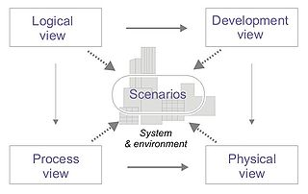
4+1 View Model (Krutchen)
▪ Logical - end users
▪ Functionality
▪ UML class, communication,
sequence diagrams
▪ Development - programmers
▪ Implementation
▪ UML package diagram
▪ Process - programmers
▪ Dynamic behavior
▪ UML activity diagram
▪ Physical - system engineers
▪ Component topology
▪ UML deployment diagram
Scenarios
▪ use-cases for system operation
▪ for illustrating, validating design
source: Wikipedia

Slide 13
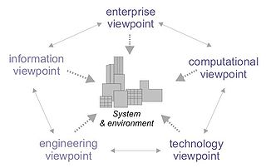
RM-ODP
(ISO/IEC 10746)
▪ Enterprise - system policies with
respect to business requirements
▪ Information - semantics of system-
managed info; data structure, content
▪ Computational - system functionality
plus functional decomposition
▪ Engineering - support for distributed
processing, including mechanisms
▪ Technology - choice of technology
▪ Emphases:
▪ object modelling
▪ distribution independence
▪ component interoperability
▪ platform and technology independence
▪ portability
▪ Includes framework for assessing conformance
source: Wikipedia

Slide 14
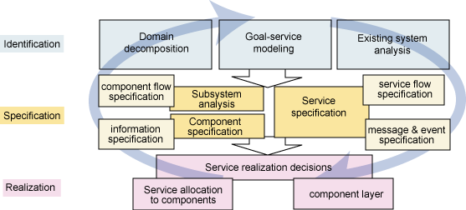
SOMA
Identification,
specification,
realization of
SOA elements:
▪ services
▪ components
▪ flows
service identification: top-down, middle-out, bottom-up
service classification: create services hierarchy
service specification: data, rules, services, configurable profile,
variations. Includes messaging and events specification
service allocation: allocating services to components; structuring
components to provide services; layering the SOA
service realization: selecting vs. custom-building services
Ali Arsenjani, http://www.ibm.com/developerworks/library/ws-soa-design1/

Slide 15
Architecture Styles
Also known as architecture patterns
Definition:
▪ set of guidelines expressing
a fundamental top-level schema
for organizing a software system
▪ provides predefined element types
(viewtypes)
▪ specifies their responsibilities
▪ gives rules and guidelines for organizing relationships amongst viewtypes

Slide 16
The Three Types of Viewtypes
Component-and-connector viewtype
▪ component: unit of processing in an executing system
e.g.: process, object, collection of objects (e.g., .dll, .so).
▪ connector: passes data around
e.g.: pipe, repository, socket, middleware.
▪ depicts runtime behavior
Module viewtype
▪ module: code unit that covers set of responsibilities
e.g.: collection (package) of classes, class, layer, function
▪ depicts static system composition
Allocation viewtype
▪ mapping of software units to environment where software resides:
e.g.,hardware, development team, file system.

Slide 17
Representative Architecture Styles
(Component and Connector Viewtypes)
Client-server
▪ Classic client-server
▪ Tiered computing
▪ Broker
▪ Proxy
Shared data
▪ Repository
▪ Tuple space
▪ Model-View-Controller
▪ Blackboard
▪ Publish-subscribe
Other
▪ Distribution tree
▪ Pipe and filter
▪ Peer-to-peer

Slide 18
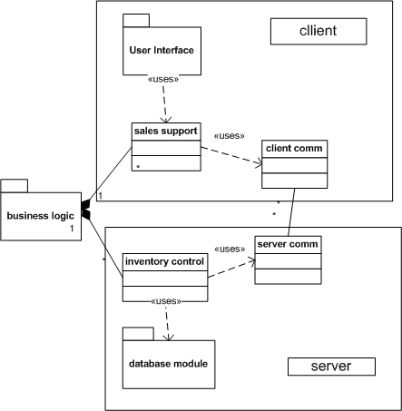
Client-Server
(example)

Slide 19
Client-Server
The classic distributed system architecture
Asymmetric: client requests service, server provides it
May have one central or multiple distributed servers
Assumes clients know types, locations of service(s)
Some issues:
▪ how many simultaneous clients are supported?
▪ can clients and/or servers be added dynamically?
▪ how are server errors and crashes handled?
▪ are sessions supported?

Slide 20
Tiered Computing
Generalization of client-server computing
Servers provide services by acting as clients to lower-level services
Classic example: middleware
▪ User application calls middleware service
e.g., ASP.NET, PHP, CORBA
▪ Middleware service calls underlying database

Slide 21
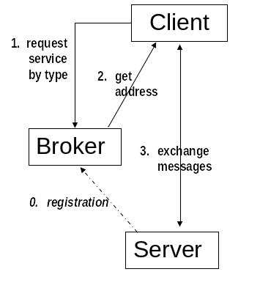
Broker
Provided by some middleware: e.g. Jini
Sequence:
▪ server registers with broker
▪ client requests service
▪ broker responds with address
▪ client,server communicate directly

Slide 22
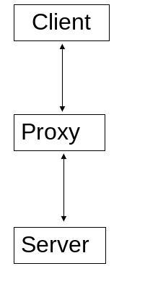
Proxy
All communication via intermediate process

Slide 23
Broker / Proxy vs. Client-Server
Broker, proxy use related mechanisms
▪ broker: delayed binding
▪ proxy: indirection
Key design principles:
▪ delayed binding sacrifies speed and
simplicity for flexibility
▪ indirection sacrifies speed and
simplicity for flexibility

Slide 24
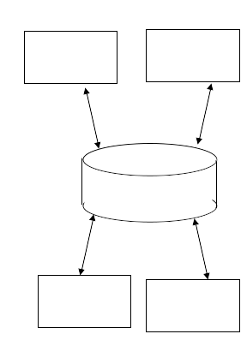
Repository
Multiple system elements communicating through shared, persistent store:
e.g.,
▪ file(s)
▪ registry key(s)
▪ database(s)

Slide 25
Tuple Space
Specialized, distributed repository where processes store, read, and retrieve tuples
▪ tuples have arbitrary size, content
▪ reading managed by pattern match
Examples: Linda (language), JavaSpaces
Advantages: conceptual simplicity, loose coupling between processes
Disadvantages: relative lack of support, scalability (processes and data aggregations)

Slide 26
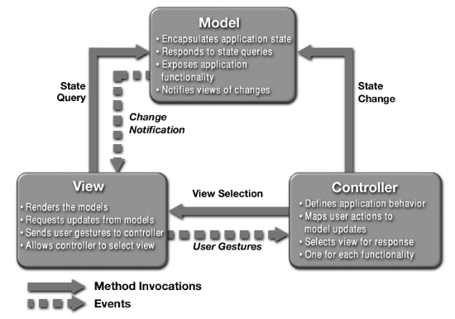
Model-View-Controller (MVC)
▪ Origin: Smalltalk
Special case of repository
▪ model = repository
▪ view(s) show
repository content
▪ controller
▪ accepts commands
▪ typically event-driven
(button-push)
▪ manages views, model

Slide 27
Model-View-Controller
Advantages
▪ should decouple model from user interface
▪ well-known: supported by toolkits
▪ conceptually simple
Disadvantages
▪ may perform poorly: many updates, much data
▪ can be overly complicated in practice
▪ can couple model to view, controller in practice

Slide 28
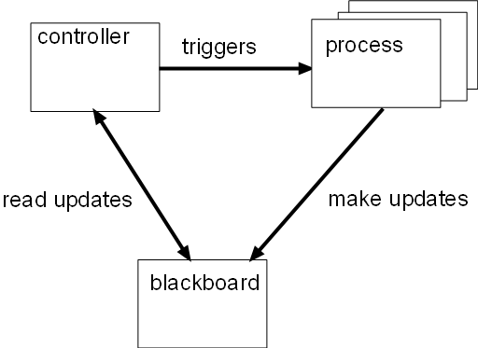
Blackboard
Like repository, but with active central store
▪ Changes to blackboard trigger events in processes
Control strategies
▪ Centralized: trigger in blackboard
▪ Distributed: triggers in processes

Slide 29
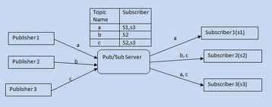
Publish-Subscribe
Like hybrid repository / blackboard
▪ One-way flow of info from publishers to subscribers
▪ Publishers store data to server (write-only repository)
▪ Subscribers register for data from server
(read-only blackboard)
▪ Data persists in server just long enough to distribute
▪ Decouples publishers from subscribers
▪ Lots of variants

Slide 30
Distribution Tree
Like publish-subscribe, but with tiered back-end distribution service
▪ Eliminate potential bottleneck at server,
due to massive number of clients
▪ Classic protocol: multicast

Slide 31
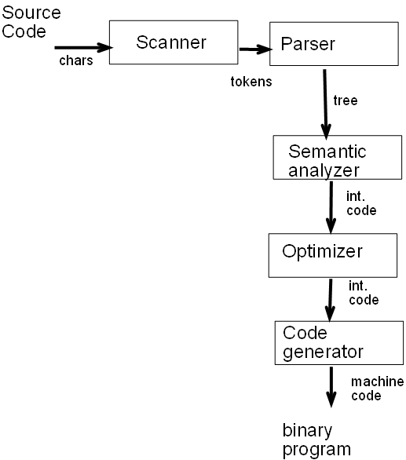
Pipe-and-Filter
Like (linear) dataflow
architecture
▪ Upstream component
accepts data…
▪ …processes it…
▪ …and passes it downstream
Architecture must coordinate data flow
▪ Buffering (asynchronous)
▪ Blocking handoff (synchronous)
Examples
▪ Compilers
▪ ETL applications

Slide 32
Pipe and Filter
Advantages
▪ simple composition
▪ reusable parts
▪ easy maintenance
▪ natural concurrency
Disadvantages
▪ problem error handling
▪ no global state
▪ restart often difficult
▪ data flow must be uniform along pipes
▪ forces batch mode processing

Slide 33
Peer-to-Peer (P2P)
Similar to client-server, but without asymmetry
Advantage: simple, robust
Disadvantage: lack of service guarantees

Slide 34
Modular Viewtypes
Layered
Decomposition
Use
Generalization
Aspects

Slide 35
Layered
Comparisons with Tiered Computing Viewtype
▪ Similarity: stack of elements
▪ Differences:
▪ Shows static organization, not run-time behavior
▪ Organized by type of abstraction, not service
Comments
▪ Some authors treat layering as an "architecture" - i.e., component-and-connector view
▪ Dr. Barrett says it isn't, for reasons above
▪ After some thought, I agree with Dr. Barrett

Slide 36
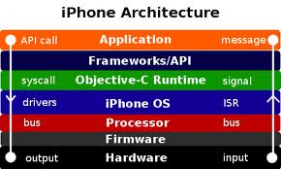
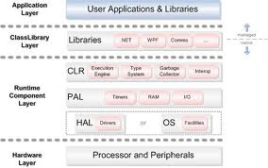
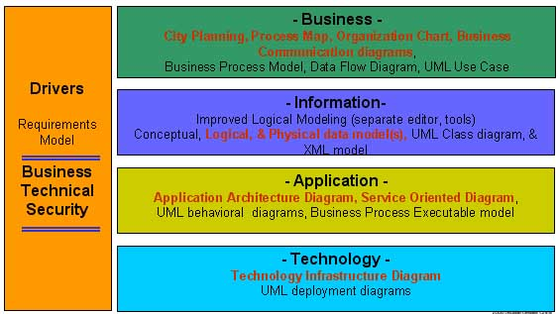
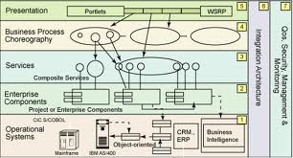
Layered Viewtype: Examples

Slide 37
Layered Viewtype: Examples
Not fully layered, but common

Slide 38
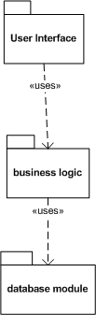
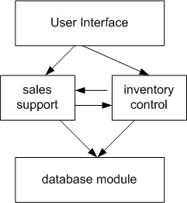
Layered Viewtype:
Other Styles of Diagrams
i.e.: <<allowed to use>>

Slide 39
Layered Viewtype: Pragmatics
Requires careful definition of layer abstractions
▪ number of layers may not be clear at first,
unless there’s a definite metaphor
▪ multiple passes usually needed
to assign functionality to layers
Each layer should have its own structure
▪ avoid “piles of classes” architectures,
where layers aren't structured

Slide 40
Layered Viewtype: Pragmatics
Decoupling adjacent layers
▪ lower layer usually ignorant of upper layers
▪ useful to hide lower layer intricacies from upper layer
▪ strategy: Façade pattern
▪ encapsulate layer's interface
▪ in one place (a flat interface)
▪ as a black box
▪ alternative to exposing many classes to upper layer

Slide 41
Layered Viewtype: Pragmatics
Inter-layer communication
▪ Avoid upcalls
where lower level uses its own function to get data from upper (analogous to content coupling)
▪ Use
▪ Pull: lower level fetches data needed from above
▪ Push: upper → lower level function call with params
▪ includes callbacks
▪ upper level registers function with lower layer
▪ lower layer invokes registered function at need
e.g.: invoke handler X on message recv()

Slide 42
Layered Viewtype: Observations
Good points
▪ encapsulation
▪ data + operations binding improves decomposition
▪ usually well insulated from change
Bad points
▪ dependent objects must share call space, e.g. parameter or local variable (contrast to pipeline)
▪ may be inefficient
▪ not all problems can be easily layered

Slide 43
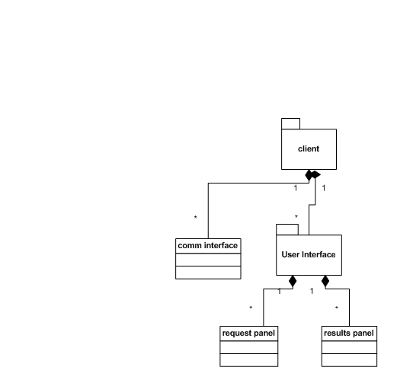
Other Modular Viewtypes
decomposition

Slide 44
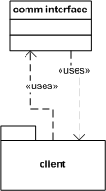
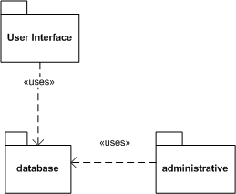
Other Modular Viewtypes
decomposition
use

Slide 45
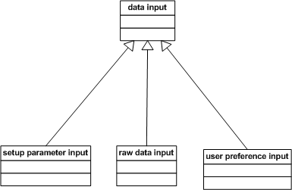
Other Modular Viewtypes
decomposition
use
generalization

Slide 46
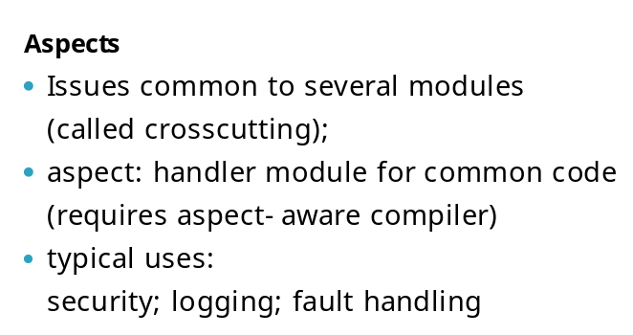
Other Modular Viewtypes
decomposition
use
generalization

Slide 47
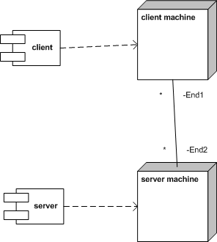
Allocation Viewtypes
Deployment style (left): where modules will be physically deployed
Work assignment style: who will do what work
▪ less detailed than WBS
Implementation style: where module codes will be stored

Slide 48
Pragmatics: Dr. Barrett
An architecture should feature at least one viewtype diagram from each of these categories:
▪ one component-and-connector
▪ one modular
▪ one allocation
Styles for subsystems may - and often do - differ from style for overall architecture

Slide 49
Design Heuristics
Seek clarity
▪ Divide complex problems into smaller ones
▪ Define functionally cohesive elements
▪ separate data producers from data consumers
Seek flexibility
▪ Keep element designs generic
▪ seek to generalize characterizations
▪ vary components -
look for "inexpensive" generalizations
▪ insulate against dependencies
on specific commercial products
▪ Anticipate contingencies
▪ assess impact of changing or negating assertions

Slide 50
Architectural Development: Phases
Pre-design
▪ determine key technologies
▪ typically in context of organizational IT
Domain analysis - assess problem area
Schematic design - create high-level models of
▪ system behavior
▪ information flow
Full design
▪ refine schematic design
▪ evaluate alternatives
Build

Slide 51


The Last Word
Every computer system has an architecture,
whether or not it is documented and understood.
Rozanski and Woods,
Software Systems Architecture

